Slide 1

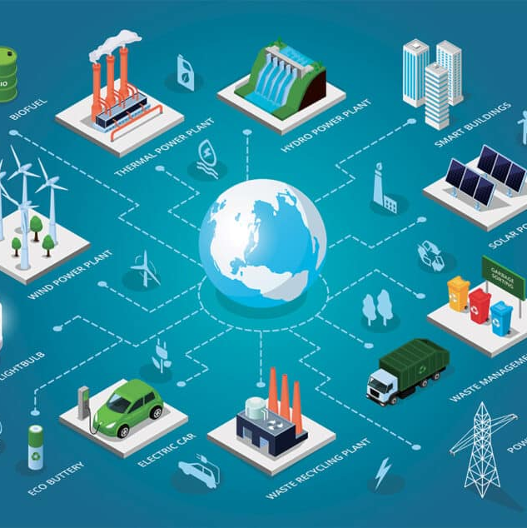
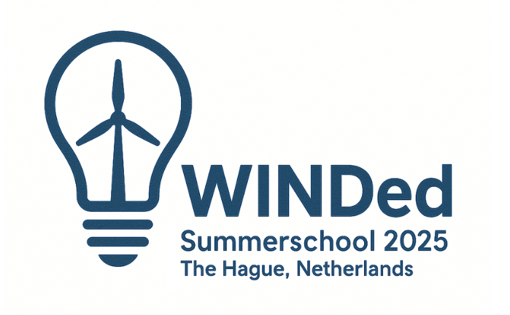
Offshore wind farms and biodiversity
Governance and policy issues in the North Sea
18 August 2025, Dr. Helena Solman, Wageningen University

Slide 2
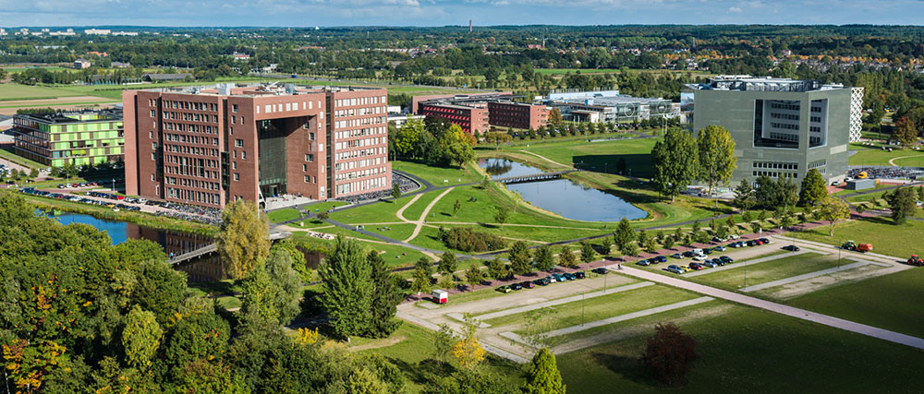

Wageningen University and Research
Notes:
About me and the uni, enp

Slide 3
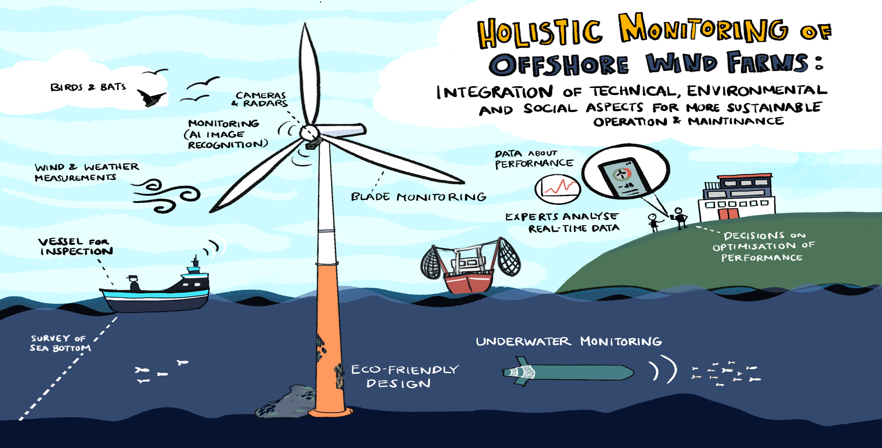
Holi-doc project: Holistic monitoring at a wind farm level
Holi-DOCTOR - HOLIstic framework for DiagnOstiCs and moniTORing of wind turbine blades
Notes:
Holi-DOCTOR - HOLIstic framework for DiagnOstiCs and moniTORing of wind turbine blades

Slide 4
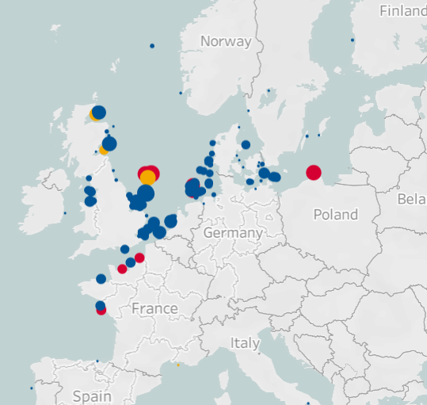
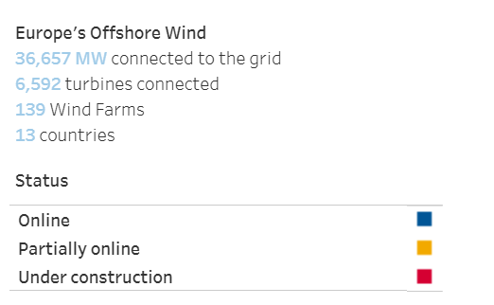
The expansion of offshore wind farms in the North Sea
76 GW of offshore wind by 2030
This interim goal
193 GW by 2040
A step towards the 2050 vision.​
260 GW by 2050
This aligns with the broader EU objective of 300 GW of offshore wind capacity by mid-century.

Slide 5
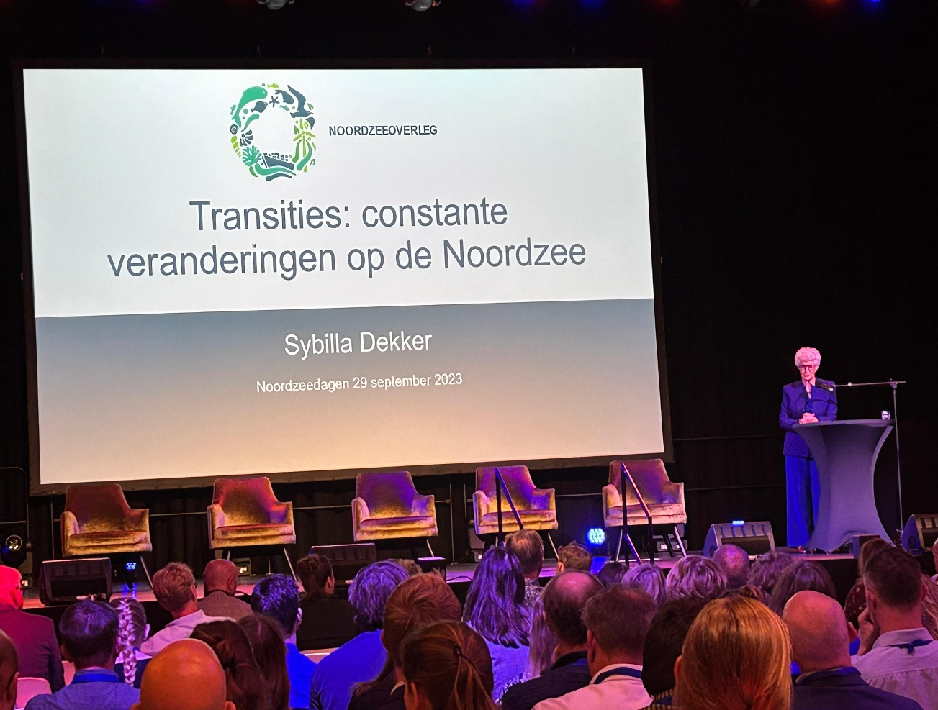
North Sea and biodiversity governance
  Policy response to the Biodiversity Crisis
Pollution from oil & gas platforms, pipelines, and marine traffic is degrading marine ecosystems.
Overfishing, habitat destruction, and climate change threaten key species like seabirds, cod, and sandeels.
Uncertain impact of wind farms?
Legal conservation efforts
Policies like the sandeel fishing ban (UK/Scotland) and marine protected areas (MPAs) aim to restore ecosystems.
Notes:
WOZEP OsPAR- role for government in this slide and for sundamental science on marine ecology

Slide 6
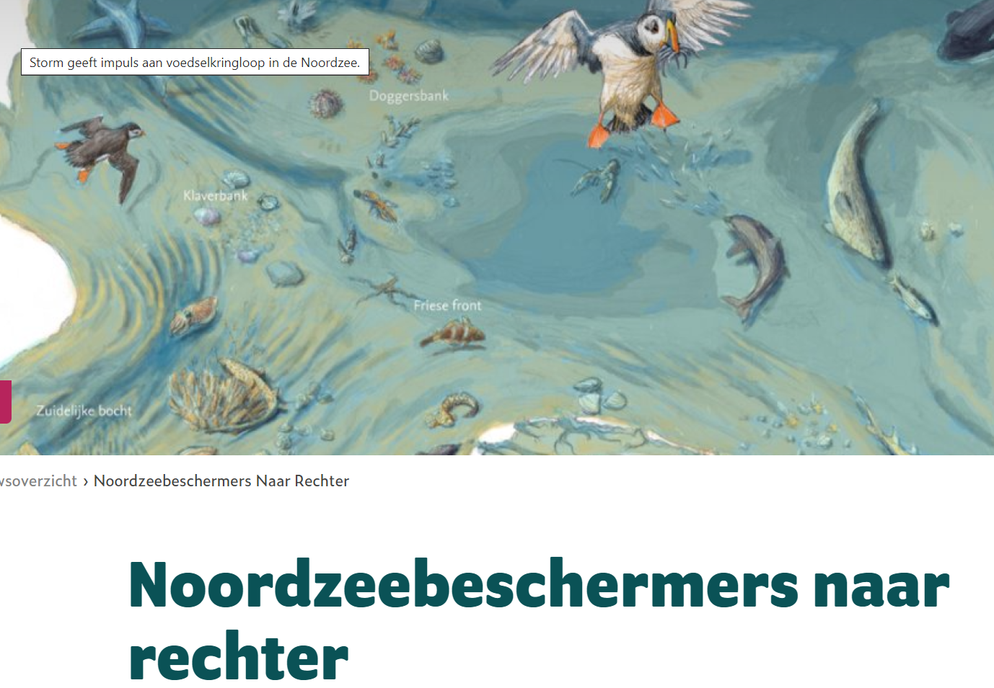
Policy-makers dillema: Offshore wind and marine biodiveristy
Upscaling trends: large scale developments- understanding impact of single and multiple wind farms
The ecological impact needs to be assessed: knowns and unknowns, but predicting the impact is difficult
Key concerns: birds, noise, fish, displacement, cumulative impacts, conflicts with other marine activities
Notes:
​Offshore wind farms in the North Sea present several ecological concerns, including:​
Habitat Disturbance: Construction and maintenance activities can disrupt seabed habitats, affecting benthic communities. ​
Collision Risks: Birds and bats face potential collisions with turbine blades, leading to fatalities. ​
Underwater Noise Pollution: Noise generated during pile-driving and operation can interfere with marine mammals' communication and navigation. ​
Changes in Fish Populations: The creation of artificial reef structures by turbines can alter local fish communities and ecosystem dynamics. ​ACS Publications
Displacement of Species: Wind farms may cause seabirds and marine mammals to avoid traditional habitats, leading to displacement. ​
Cumulative Impacts: The combined effects of multiple wind farms can lead to significant ecological changes over large areas. ​
Electromagnetic Fields (EMF) Concerns: Subsea cables emit EMFs that may affect the behavior and physiology of marine organisms. ​ScienceDirect
Altered Hydrodynamics: Wind farms can change water flow patterns, potentially impacting sediment transport and nutrient distribution. ​Nature
Conflicts with Fisheries and Marine Activities: Wind farm installations can restrict access to traditional fishing grounds and other marine uses.

Slide 7
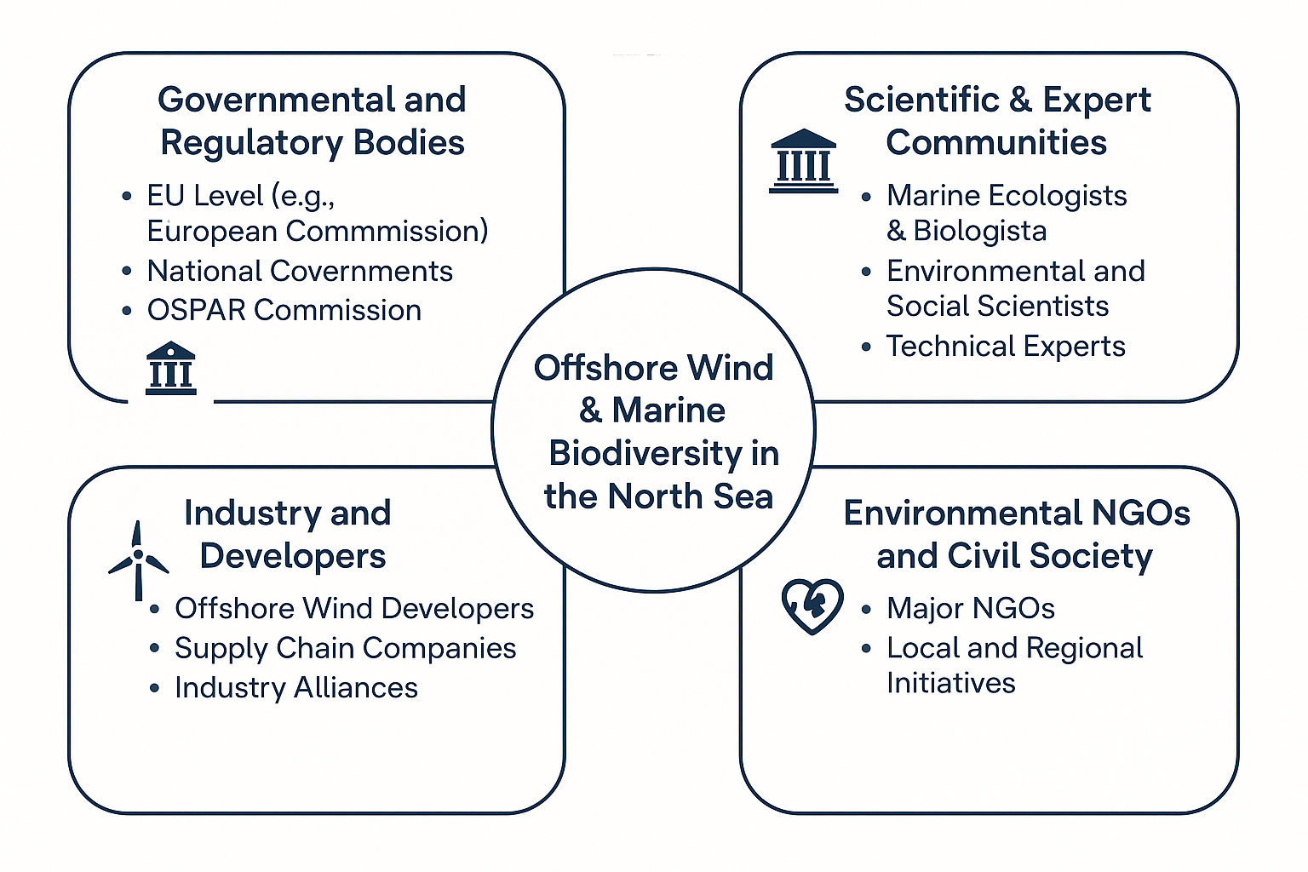
Actors in the policy arena

Slide 8
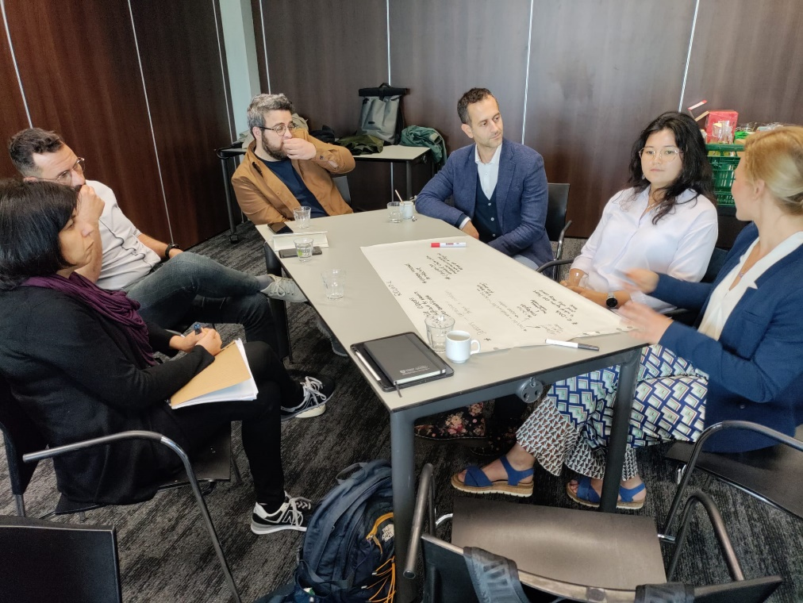
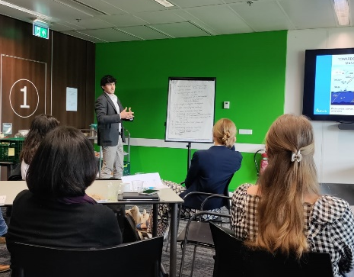
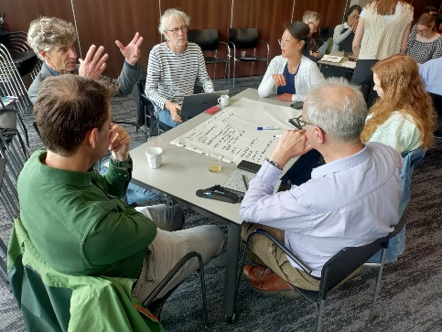
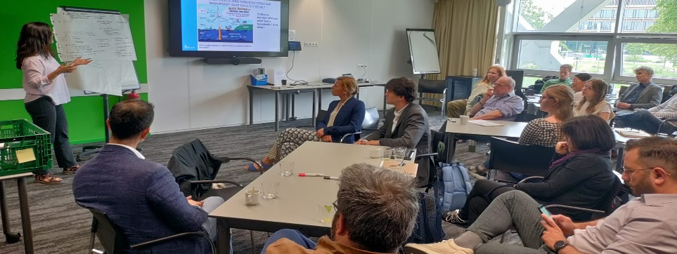
Bringing stakerholders and experts together

Slide 9
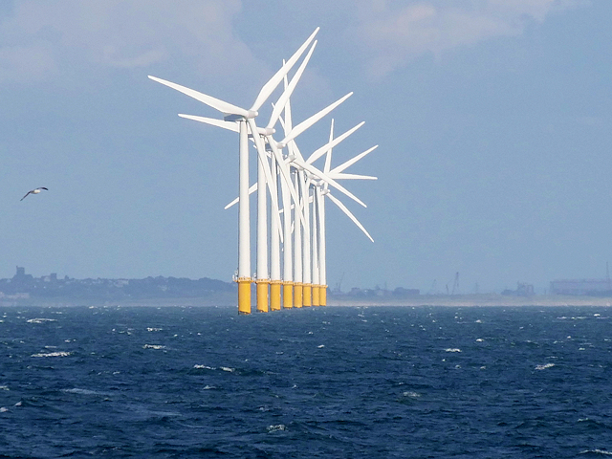
Governance approach: Searching for a win-win for offshore wind energy sector and biodiversity?
“A hand on the tap approach”
Measuring is knowing
To get rid of uncertainty
Busting myths and ending speculations/false accusations
Important role of R&I
Knowledge day Wozep/MONS 2024 - Noordzeeloket UK

Slide 10
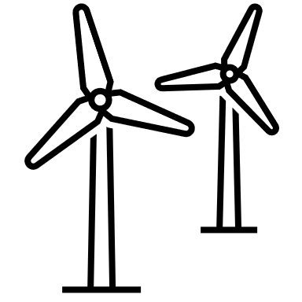
Dutch Offshore Wind Tender: Ecology in Focus
Tenders managed by RVO follow a structured 7-phase process.
Tender Highlights
Permits awarded via competitive tenders
Evaluation includes qualitative criteria, not just price.
Ecology now plays a central role in bid evaluation.
Ecological Emphasis
Criteria include:
  Impact on marine ecosystems
  Bird migration and underwater noise
  Habitat protection and restoration
Bidders must propose ecological monitoring and innovation
Interesting Facts​
Dutch offshore wind farms have been subsidy-free since 2019.​
The IJmuiden Ver tender included circularity and CSR.​
Ecology can outweigh price in some tenders—policy shift!
How does awarding a permit for an offshore wind farm work? | RVO.nl
Dutch wind farm zones: Offshorewind RVO

Slide 11
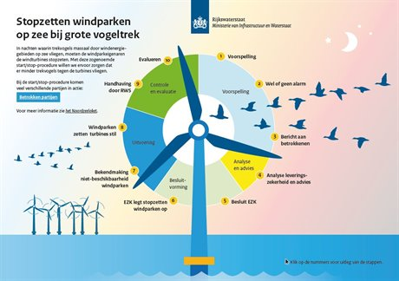
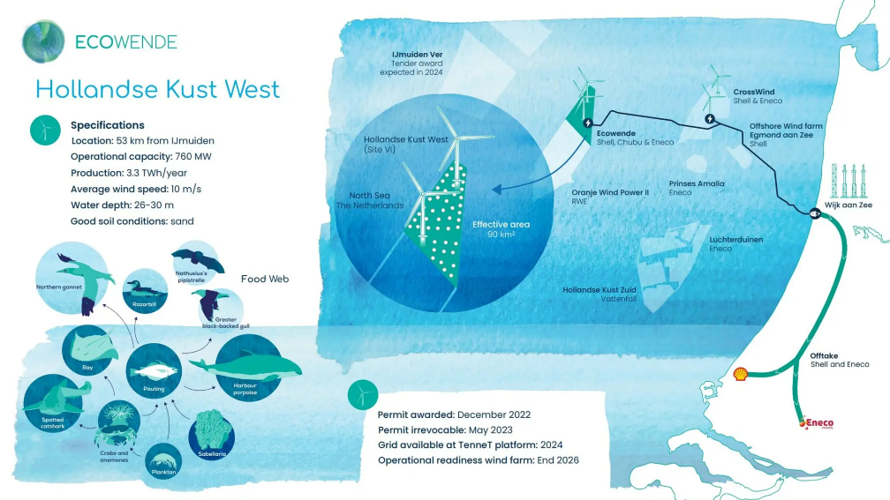
Governing biodiversity monitoring in the offshore wind in the North Sea : examples from NL
Biodiversity innovation: monitoring and offsetting impacts (new tenders)
“With Ecowende, we will take a huge step by building the most ecological wind farm yet. By doing so, we want to help make a positive contribution to biodiversity and thus accelerate the large-scale roll-out of offshore wind in the Netherlands and beyond.”

Slide 12
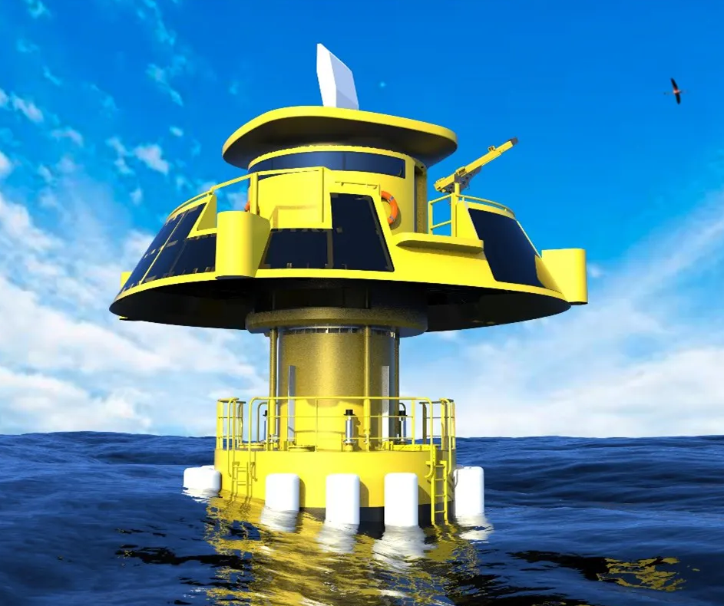
Measuring Ecological Impacts of Offshore Wind Farms in the North Sea
Environmental Impact Assessments (EIAs)
evaluates the potential environmental impacts of offshore wind farms during their construction, operation, and decommissioning phases. It ensures that projects are compatible with marine ecosystem health and comply with national and EU regulations
Includes: baseline environmental survey, impact assessment, mitigation measures, consultation and reporting
About £11 million for a 1 GW wind farm.

Slide 13
Human Impact studies
Human impact studies assess the impact that a proposed wind farm may have on the community living in and around the coastal area near the wind farm including assessing visual and socio-economic impacts.
About £770,000 for a 1 GW offshore wind farm.
Includes visual assessment, archeology, impact on fisheries and noise impacts
socio-economic study assesses the impacts of a wind farm or coastal infrastructure, for example a port, such as changes in employment, transportation or recreation, or changes in the aesthetic value of a landscape.

Slide 14
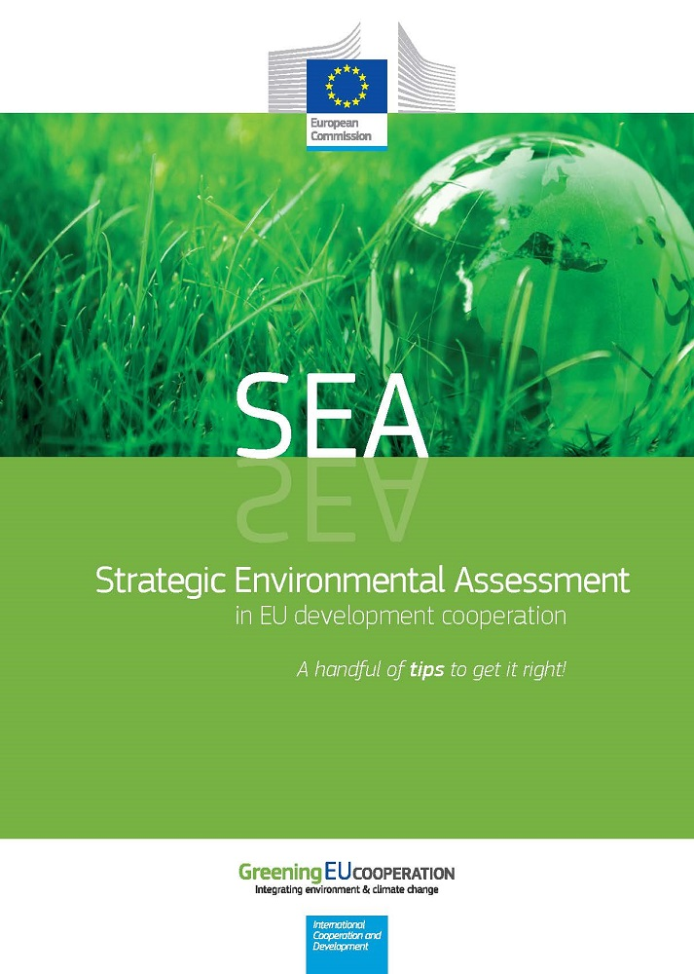
Strategic Environmental Assessments(SEAs) for offshore wind projects
Is a high-level, policy-focused evaluation of the environmental effects of plans and programs, such as national strategies for offshore wind development. Unlike EIAs, which assess specific projects, SEAs look at broader planning frameworks and help guide sustainable decision-making before individual projects are proposed
Strategic Environmental Assessment North Seas Energy (SEANSE) | The European Maritime Spatial Planning Platform
Developed the Common Environmental Assessment Framework (CEAF) to harmonize SEA practices.
Focused on cumulative effects of offshore wind energy across the North Sea

Slide 15
Initiatives from the wind energy sector
Tenders with points for ecological innovation
Experimental solutions for biodiversity net positive impacts
Monitoring using digital tech
Evaluation of the impact
Energy projects with a net-positive impact on biodiversity
“We’re bringing together action on two urgent challenges that are too often addressed separately: halting and reversing biodiversity loss and preventing catastrophic climate change. Both crises are deeply interconnected, and to solve either, we must find and deliver solutions that support both climate and biodiversity goals”
What is Biodiversity & How Are We Protecting It? | Ørsted

Slide 16
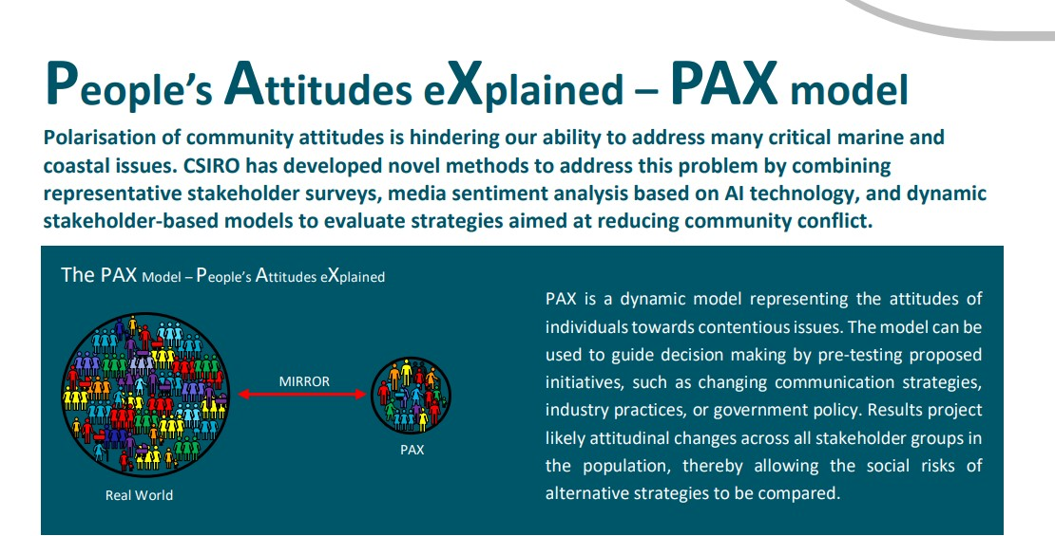
Initiatives from academia: Adopting innovation and using the potential of AI for decision-making

Slide 17
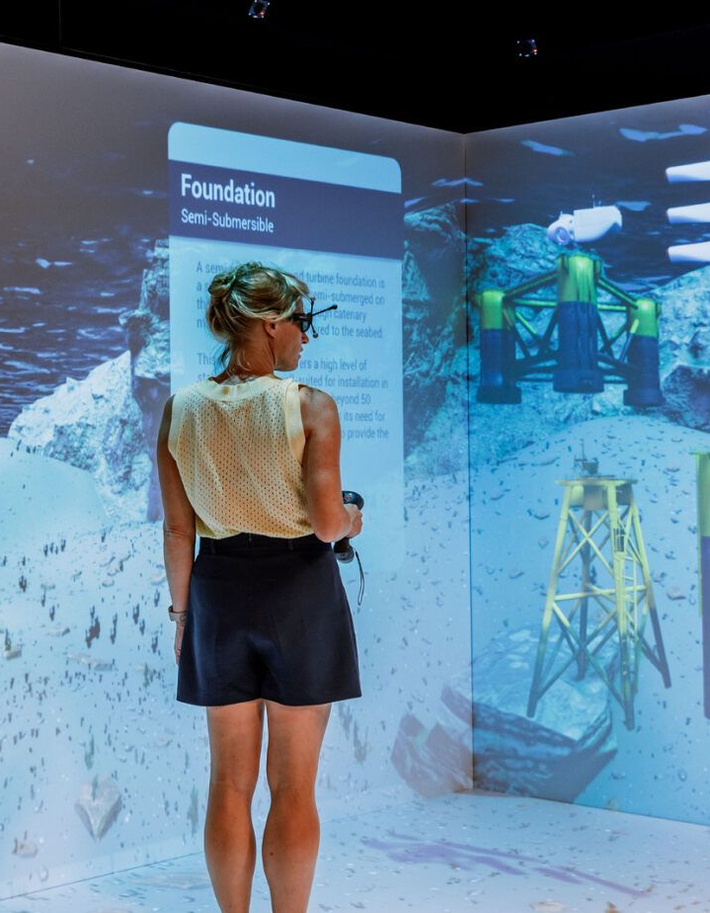
Knowledge, skills and education – green and digital
Domain and interdisciplinary knowledge + Collaboration skills
Key findings:
The offshore wind sector is facing a major skills shortage—not just in numbers, but in the diversity of expertise needed. Academic and the industry started using digital twins and immersive VR tools to accelerate training and retraining, especially for operations and maintenance roles, but also for planning and environmental monitoring. These technologies let people gain near real-life experience without setting foot offshore.
Key innovation: combining technical tasks with environmental scenarios—like simulating a turbine inspection alongside marine biodiversity monitoring—so that trainees don’t just learn how to maintain a turbine but understand the ecosystem it’s part of.
Digital and green transition: building a more integrated, cross-disciplinary workforce faster.
Notes:
Training infrastructure for offshore wind jobs - Soulmade

Slide 18
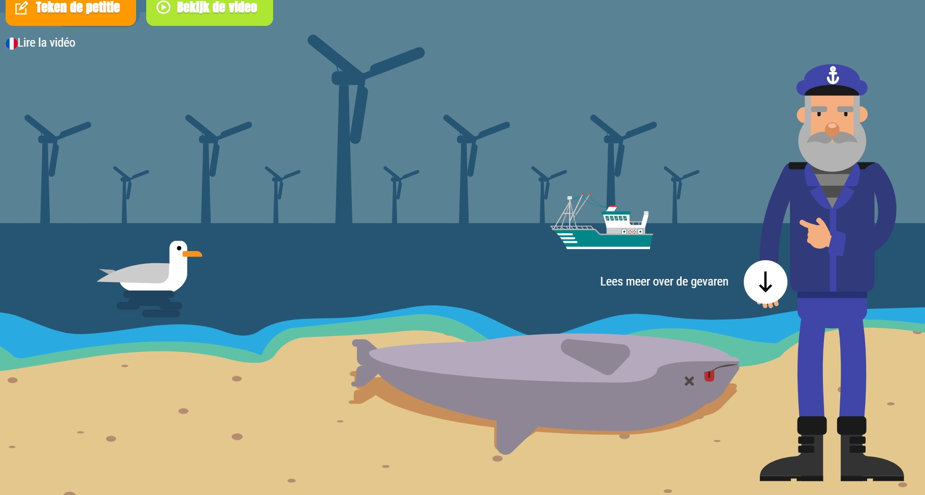
Digital collaboration: Co-existence/ co-management
Fishers offer participation: new jobs, sharing data, common concern about the marine environment

Slide 19
Brainstorm:
"How should governments balance the urgent need for offshore wind energy expansion with the long-term protection of marine biodiversity—and who should be responsible for making those trade-offs?"

Slide 20
Governance implications of digital biodiversity monitoring and management
Inclusion and exclusion of different ecological aspects
Spatial Boundaries of monitoring- in/outside wind farm area
Finding synergies with other sectors and stakeholder collaboration
Long-term ambition: digital and optimal techno-socio-ecological system management
New issues: security, data sharing and communication
Interdisciplinary research and innovation

Slide 21
From public to private governance
Governance Aspect | Public-led Approach | Private-led Approach
Policy Instruments | Environmental Impact Assessments (EIAs), strategic frameworks, permitting procedures | Internal corporate sustainability frameworks and standards
Regulatory Tools | Tenders and auctions with criteria for sustainability and biodiversity | Voluntary commitments aligned with company values and ESG strategies
Incentives | Extra points or advantages in auction/tender scoring for biodiversity initiatives | Brand value, social license to operate, investor expectations
Biodiversity Actions | Legally required mitigation and monitoring efforts | Voluntary biodiversity offsetting, habitat restoration, biodiversity net gain targets
Monitoring and Reporting | Mandated environmental monitoring and reporting | Company-led monitoring programs; often more innovative or long-term
Overall Governance Logic | Compliance-driven, top-down, state-coordinated | Voluntary, market- and reputation-driven, flexible and adaptive

Slide 22
New, holistic management approach: towards collaborative eco-system-based governance of offshore wind farms
Evidence-based solutions (nature-based solutions, multifunctional wind farms)
Real-time management (e.g., smart curtailment)
Transboundary management (digital twin of the North Sea
What counts? Defining “good” accepting the costs?
Who decides? Trades-offs exist
Sharing data, transdisciplinary R&I

Slide 23
Thank you for listening! Questions? Comments?
What are good outcomes for offshore wind and biodiversity? What’s your view?

Slide 24

Stay in touch!
Email: Helena.solman@wur.nl
dr. HM (Helena) Solman MSc - WUR
Connect on Linkedin
Check out our university: WUR

